Slide 1
Welcome to Databyte Workshop

Slide 2
REGRESSION MODELS

Slide 3
What is a Math/Stats Model?
Often Describe Relationship between Variables
Types
    Deterministic Models (no randomness)
    Probabilistic Models (with randomness)
Notes:
.

Slide 4
Deterministic Models
Hypothesize Exact Relationships
Suitable When Prediction Error is Negligible
Example: Body mass index (BMI) is measure of body fat based
  Metric Formula: BMI = Weight in Kilograms
  (Height in Meters)²
  Non-metric Formula: BMI = Weight(pounds)x703 (Height in inches)²

Slide 5
Probabilistic Models
Hypothesize 2 Components
    Deterministic
    Random Error
Example: Systolic blood pressure of newborns Is 6 Times the Age in days + Random Error
    SBP = 6xage(d) + ε
    Random Error May Be Due to Factors Other Than age in days (e.g. Birthweight)

Slide 6
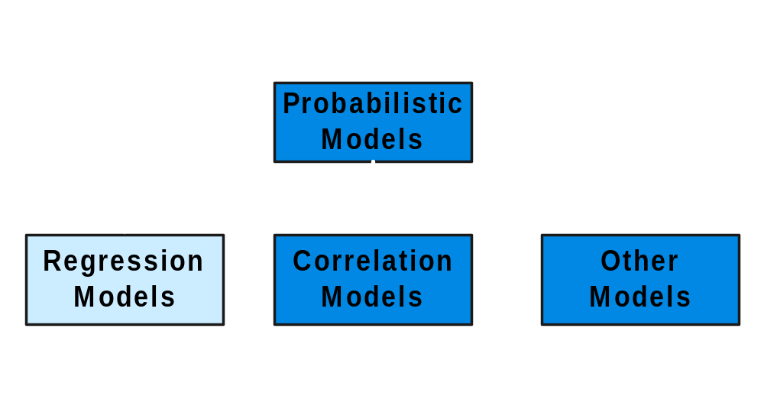
Types of
Probabilistic Models
Notes:
7

Slide 7
Regression Models
Notes:
13

Slide 8
Regression Models
Relationship between one dependent variable and explanatory variable(s)
Use equation to set up relationship
    Numerical Dependent (Response) Variable
    1 or More Numerical or Categorical Independent (Explanatory) Variables
Used Mainly for Prediction & Estimation

Slide 9
Regression Modeling Steps
1. Hypothesize Deterministic Component
    Estimate Unknown Parameters
2. Specify Probability Distribution of Random Error Term
    Estimate Standard Deviation of Error
3. Evaluate the fitted Model
4. Use Model for Prediction & Estimation

Slide 10
Specifying the deterministic component
1. Define the dependent variable and independent variable
2. Hypothesize Nature of Relationship
  Expected Effects (i.e., Coefficients’ Signs)
  Functional Form (Linear or Non-Linear)
  Interactions

Slide 11
Types of
Regression Models
1 Explanatory
Regression
2+ Explanatory
Variable
Models
Variables
Simple
Multiple
Non-
Non-
Linear
Linear
Linear
Linear
Notes:
24
This teleology is based on the number of explanatory variables & nature of relationship between X & Y.

Slide 12
Linear Regression Model
Notes:
26

Slide 13
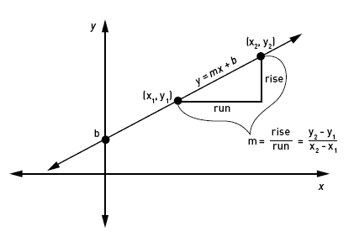
Linear Equations
© 1984-1994 T/Maker Co.
Notes:
28

Slide 14
Linear Regression Model
1. Relationship Between Variables Is a Linear Function
Population
Y-Intercept
Population Slope
Random Error
Y
=
β
+
β
X
+
ε
i
0
1
i
i
Dependent (Response) Variable
(e.g., CD+ c.)
Independent (Explanatory) Variable
(e.g., Years s. serocon.)

Slide 15
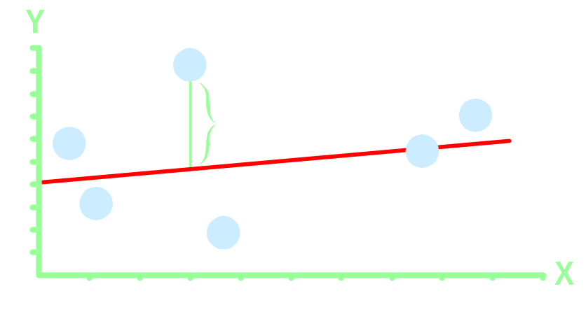
Population Linear Regression Model
Observedvalue
ε_{i} = Random error
Observed value
Notes:
35

Slide 16
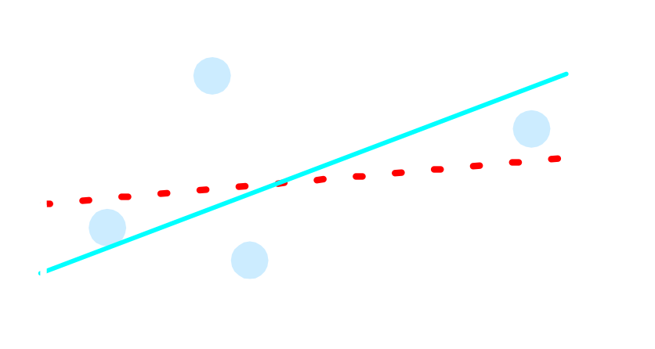
Sample Linear Regression Model
ε_{i} = Random error
^
Unsampled observation
Observed value
Notes:
36

Slide 17
Estimating Parameters:
Least Squares Method
Notes:
40

Slide 18
Scatter plot
1. Plot of All (X_{i}, Y_{i}) Pairs
2. Suggests How Well Model Will Fit
Y
60
40
20
0
X
0
20
40
60

Slide 19
Thinking Challenge
How would you draw a line through the points? How do you determine which line ‘fits best’?
Y
60
40
20
0
X
0
20
40
60
Notes:
42

Slide 20
Thinking Challenge
How would you draw a line through the points? How do you determine which line ‘fits best’?
Slope changed
Y
60
40
20
0
X
0
20
40
60
Intercept unchanged
Notes:
43

Slide 21
Thinking Challenge
How would you draw a line through the points? How do you determine which line ‘fits best’?
Slope unchanged
Y
60
40
20
0
X
0
20
40
60
Intercept changed
Notes:
44

Slide 22
Thinking Challenge
How would you draw a line through the points? How do you determine which line ‘fits best’?
Slope changed
Y
60
40
20
0
X
0
20
40
60
Intercept changed
Notes:
45

Slide 23
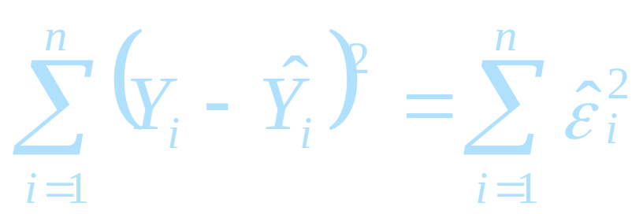
Least Squares
1. ‘Best Fit’ Means Difference Between Actual Y Values & Predicted Y Values Are a Minimum. But Positive Differences Off-Set Negative. So square errors!
2. LS Minimizes the Sum of the Squared Differences (errors) (SSE)
Notes:
51

Slide 24
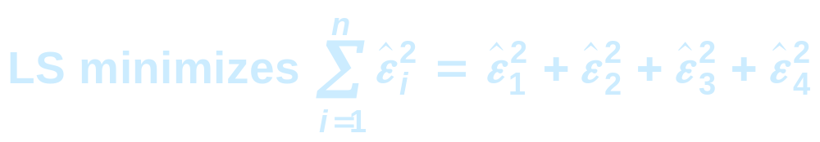

Least Squares Graphically
Notes:
52

Slide 25
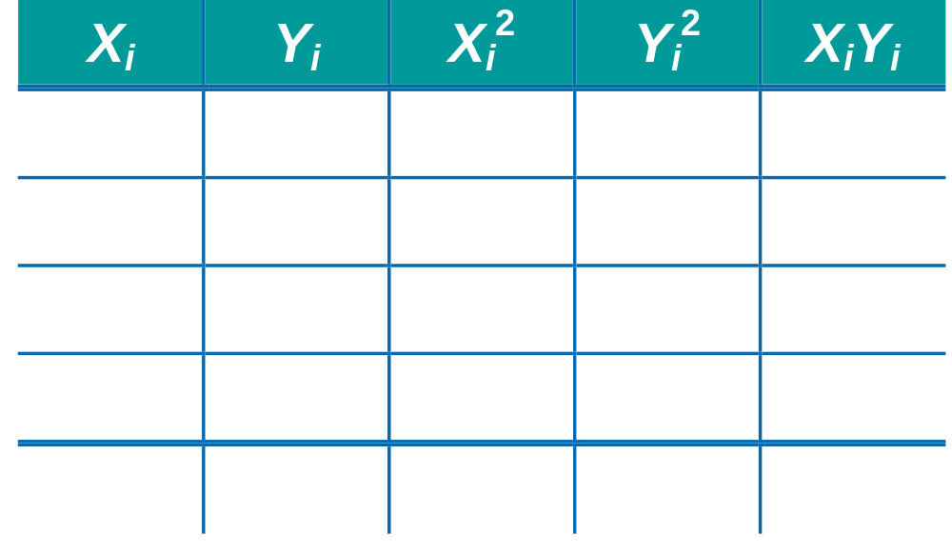
Computation Table
Notes:
54

Slide 26
Interpretation of Coefficients
1. Slope (β₁)
  Estimated Y Changes by β₁ for Each 1 Unit Increase in X
    If β₁ = 2, then Y Is Expected to Increase by 2 for Each 1 Unit Increase in X
2. Y-Intercept (β₀)
  Average Value of Y When X = 0
    If β₀ = 4, then Average Y Is Expected to Be 4 When X Is 0

